Slide 1
Big Data Analytics
for Business
IS 843 - Spring ‘22
Lecture 04
Professor: Mohammad Soltanieh-ha

Slide 2
Topics covered
More on SQL
Joins
Spark

Slide 3
Unique Keys
A primary key is a table column (or combination of columns) designated to uniquely identify all table records.
A primary key’s main features are:
It must contain a unique value for each row of data
It cannot contain null values
What is a good primary key in the customer_churn dataset?

Slide 4
Unique Keys
A primary key is a table column (or combination of columns) designated to uniquely identify all table records.
A primary key’s main features are:
It must contain a unique value for each row of data
It cannot contain null values
What is a good primary key in the customer_churn dataset?
SELECT customerID, count(*) repeat FROM `examples.customer_churn`
GROUP BY customerID
HAVING repeat > 1

Slide 5
STRING_AGG() Function
Returns an aggregated value obtained by concatenating non-null values.
If a delimiter is specified, concatenated values are separated by that delimiter; otherwise, a comma is used as a delimiter.
SELECT Contract,
COUNT(*) AS NumberOfCustomers,
COUNT(DISTINCT PaymentMethod) AS NumberOfPaymentMethod,
STRING_AGG(DISTINCT PaymentMethod, " - " ORDER BY PaymentMethod LIMIT 10) AS PaymentMethods
FROM `examples.customer_churn`
GROUP BY Contract
ORDER BY NumberOfCustomers DESC

Slide 6
WITH SQL Clause
You can use the SQL WITH clause to help break apart a complex query into multiple steps.
WITH hamlet AS
(SELECT * EXCEPT (corpus_date) FROM `bigquery-public-data.samples.shakespeare`
WHERE corpus = 'hamlet')
SELECT word from hamlet
ORDER BY word_count DESC
LIMIT 10

Slide 7
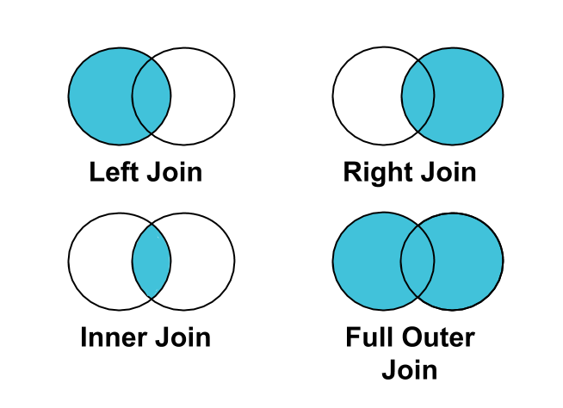
SQL Joins
A JOIN clause is used to combine records from two tables, based on related column(s) between them.

Slide 8
JOIN Types
[INNER] JOIN: requires that key values exist in both tables for the records to appear in the results table. Records appear in the merge only if there are matches in both tables for the key values.
LEFT [OUTER] JOIN: Each row in the left table appears in the results, regardless of whether there are matches in the right table.
RIGHT [OUTER] JOIN: the reverse of a left join. Each row in the right table appears in the results, regardless of whether there are matches in the left table.
FULL [OUTER] JOIN: Left join + Right join, which returns all records from both tables regardless of matching join keys.
CROSS JOIN: combines each row of the first dataset with each row of the second dataset, where every combination is represented in the output. Use with caution!

Slide 9
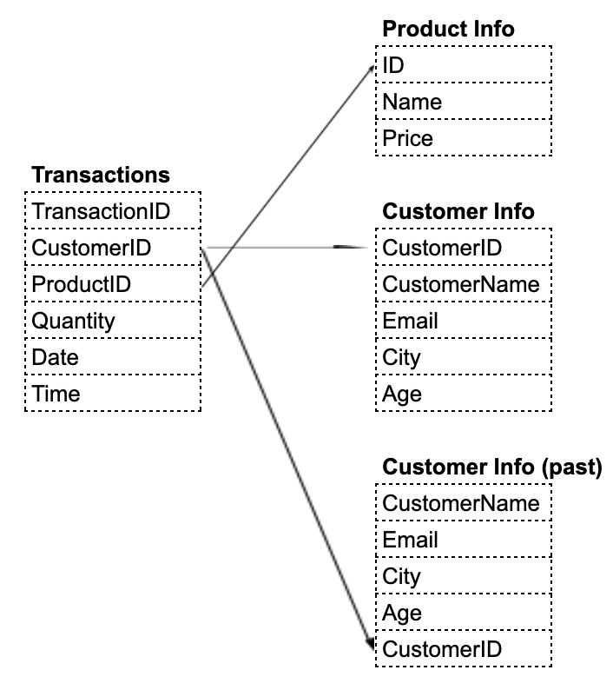
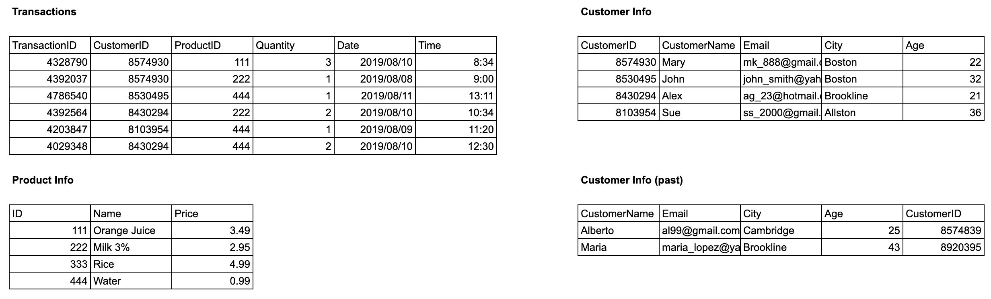
Sample Data
Google Sheet here.

Slide 10
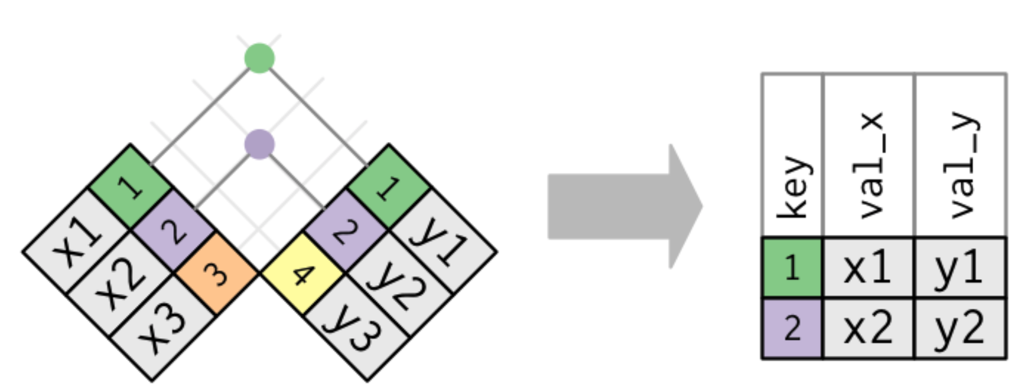
[INNER] JOIN
SELECT
A.*,
B.CustomerID,
B.Quantity,
B.Date
FROM
`ba-770.public.product_info` A
INNER JOIN
`ba-770.public.transactions` B
ON A.ID = B.ProductID
Returns all the products with their corresponding transactions where a product match exists in both tables. It also appends additional columns from table B: CustomerID, Quantity, Date.
The INNER JOIN (or simply JOIN) selects all rows from both participating tables as long as there is a match between the joining columns specified by ON.

Slide 11
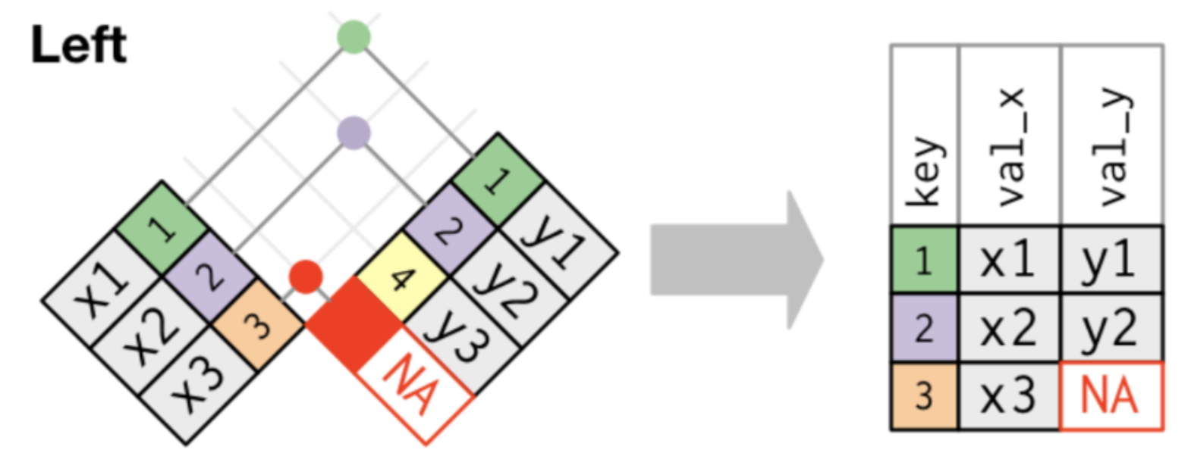
LEFT [OUTER] JOIN
SELECT
A.*,
B.CustomerID,
B.Quantity,
B.Date
FROM
`ba-770.public.product_info` A
LEFT JOIN
`ba-770.public.transactions` B
ON A.ID = B.ProductID
Returns all the products from table A with their corresponding transactions (even if there is none). It also appends additional columns from table B: CustomerID, Quantity, Date.
The LEFT OUTER JOIN (or simply LEFT JOIN) selects all rows from the left table and brings additional column(s) from the table on the right.

Slide 12
RIGHT [OUTER] JOIN
The result of a RIGHT OUTER JOIN (or simply RIGHT JOIN) is similar and symmetric to that of LEFT OUTER JOIN. You can get the same output if you change LEFT to RIGHT and replace the position of the tables in the JOIN statement. The following joins are equivalent:
SELECT A.*, B.CustomerID,
B.Quantity, B.Date
FROM `ba-770.public.product_info` A
LEFT JOIN `ba-770.public.transactions` B
ON A.ID = B.ProductID
SELECT A.*, B.CustomerID,
B.Quantity, B.Date
FROM `ba-770.public.transactions` B
RIGHT JOIN `ba-770.public.product_info` A
ON A.ID = B.ProductID

Slide 13
FULL [OUTER] JOIN
A FULL OUTER JOIN (or simply FULL JOIN) returns all fields for all rows in both tables that meet the join condition.
SELECT A.*, B.Quantity
FROM `ba-770.public.product_info` A
FULL JOIN `ba-770.public.transactions` B
ON A.ID = B.ProductID

Slide 14
CROSS JOIN
A cross join combines each row of the first data set with each row of the second dataset, where every combination is represented in the output. As a result, the number of total rows in the join are:
Rows(TableA) * Rows(TableB)
NOTE: Depending on the size of your datasets, a cross join can greatly expand the size of the output, which may increase costs in some environments.
SELECT A.Name, B.*
FROM `ba-770.public.product_info` A
CROSS JOIN `ba-770.public.transactions` B

Slide 15
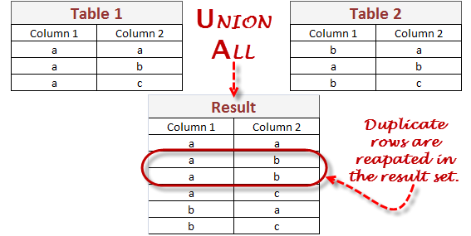
UNION ALL & UNION DISTINCT
SELECT CustomerID, CustomerName, Email, City, Age FROM `ba-770.public.customer_info`
UNION ALL
SELECT CustomerID, CustomerName, Email, City, Age FROM `ba-770.public.customer_info_past`
UNION ALL will merge two queries. They must have same column name/type. Duplicates, if any, will persist.
UNION DISTINCT will remove the duplicates during the merge.

Slide 16

Your Turn - Lab Session
Weather Data in BigQuery - 00:45
What you will learn in this lab
Carry out interactive queries on the BigQuery console.
Combine and run analytics on multiple datasets.
**NOTE** OPEN QWIKLABS IN AN incognito MODE GOOGLE CHROME PAGE

Slide 17


Slide 18
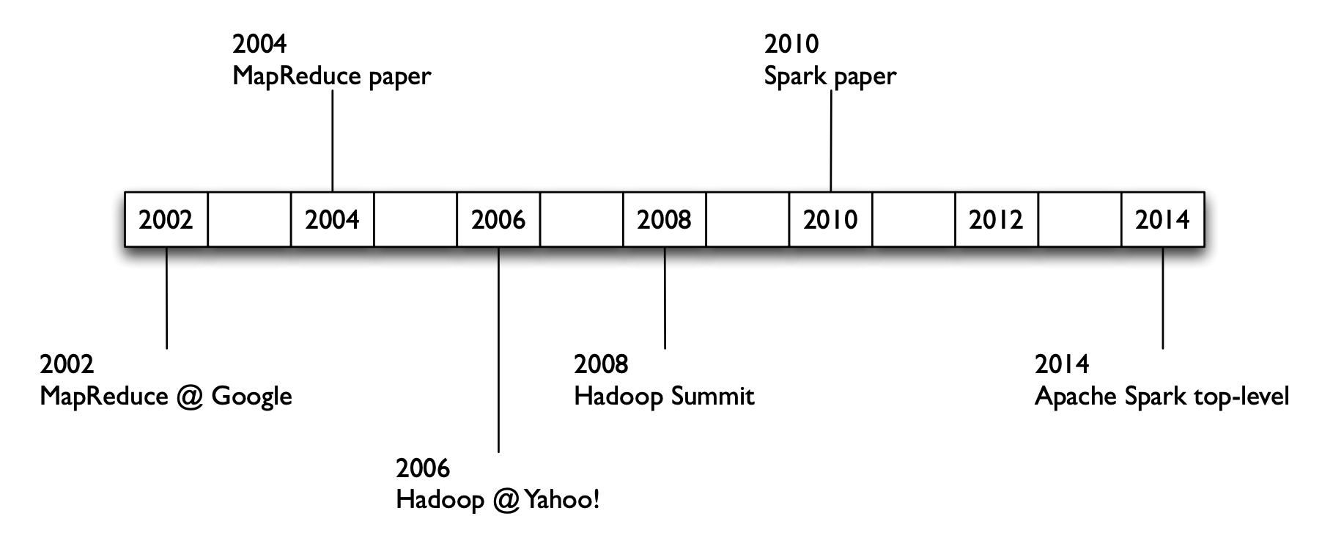
What is Apache Spark?
Apache Spark is a unified computing engine and a set of libraries for parallel data processing on computer clusters.
Created by AMPLab – UC Berkeley (same people who made Databricks later)
Open sourced in 2010. Lives on GitHub
Written in Scala
Available in
Python
Java
Scala
R

Slide 19
Unified Computing Engine
Spark is designed to support a wide range of data analytics tasks, ranging from simple data loading and SQL queries to machine learning and streaming computation, over the same computing engine and with a consistent set of APIs.
Because of its unified nature, it can optimize across different libraries and functions. For example, if you load data using a SQL query and then evaluate a machine learning model over it using Spark’s ML library, the engine can combine these steps into one scan over the data.
Spark focuses on being a compute engine rather than a permanent storage solution, meanwhile, it can handle loading data from various storage systems such as:
HDFS
Google Cloud Storage
AWS S3

Slide 20
Libraries
Standard libraries - included in the installation
Spark SQL - SQL and structured data
MLlib - machine learning
Spark Streaming
Third-party libraries by the community

Slide 21
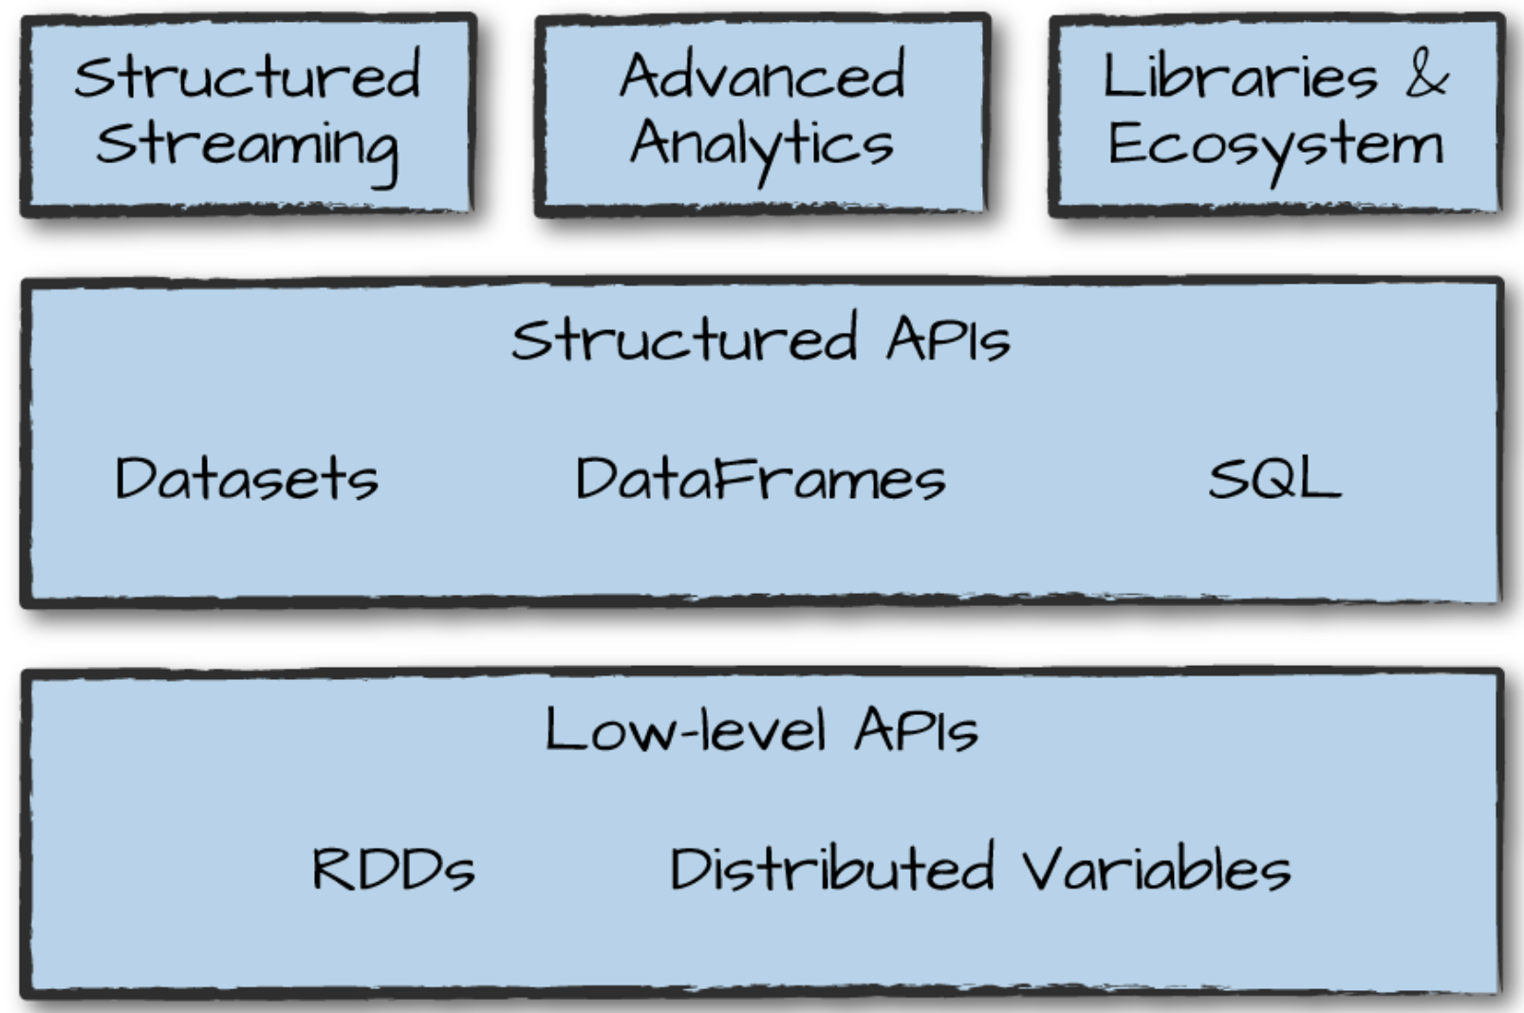
Spark’s toolkit

Slide 22
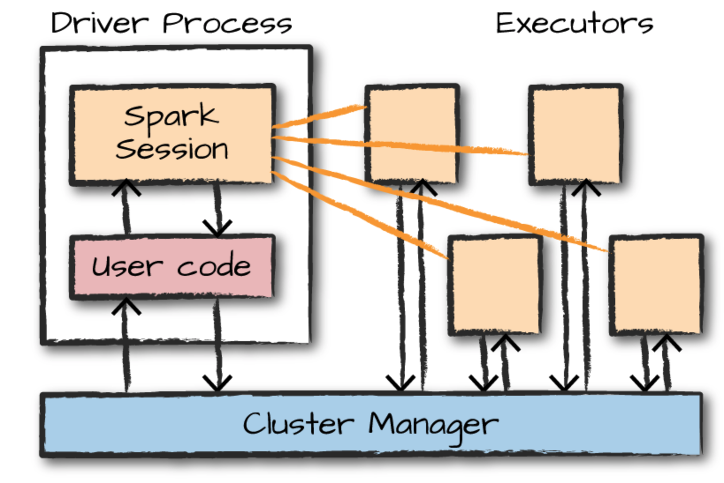
Spark’s Basic Architecture
Cluster Manager can be one of these three:
Spark’s standalone
YARN
Mesos

Slide 23
Spark Applications
Spark Applications consist of:
Driver process: runs your main() function, sits on a node in the cluster. Responsible for:
maintaining information about the Spark Application
responding to a user’s program or input
analyzing, distributing, and scheduling work across the executors
Executor process(es): sits on cluster nodes. Each executor is responsible for:
executing code assigned to it by the driver
reporting the state of the computation on that executor back to the driver node

Slide 24
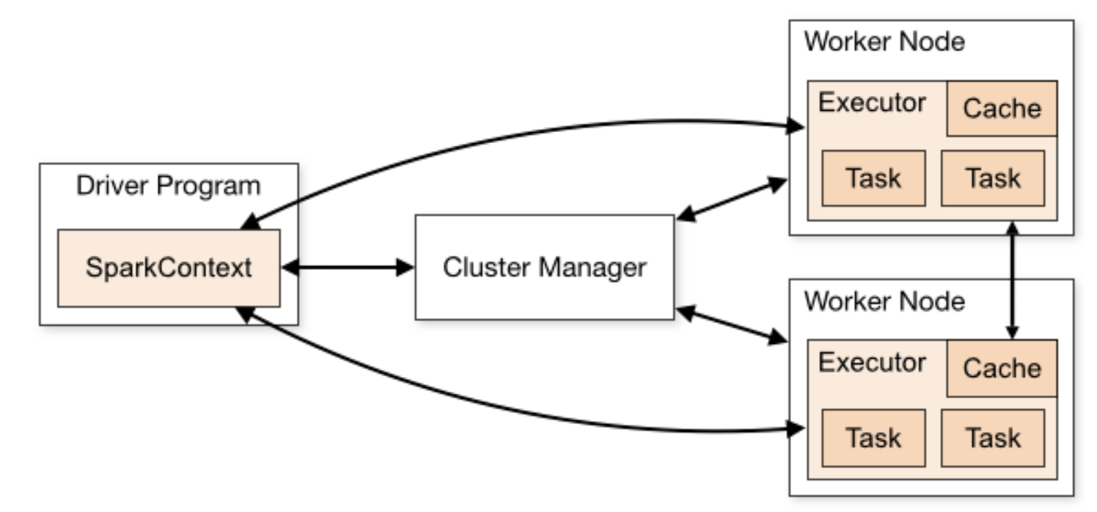
Spark Cluster Manager
Spark applications run as independent sets of processes on a cluster, coordinated by the SparkContext object in your main program (called the driver program).
SparkContext connects to the cluster manager
Spark acquires executors on nodes in the cluster
Spark sends your application code (Python files passed to SparkContext) to the executors
SparkContext sends tasks to the executors to run
Source: Spark documentation

Slide 25
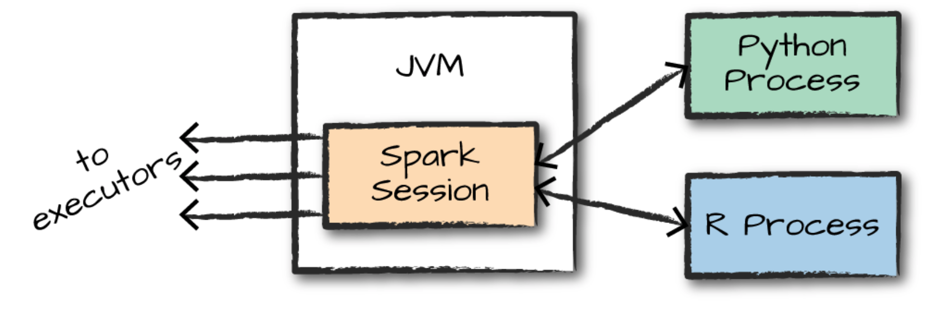
Spark’s Language APIs
There is a SparkSession object available to the user, which is the entry point to executing Spark code and user-defined manipulations across the cluster.
When using Spark from Python or R, you don’t write explicit JVM instructions; instead, you write Python and R code that Spark translates into code that it then can run on the executor JVMs.

Slide 26
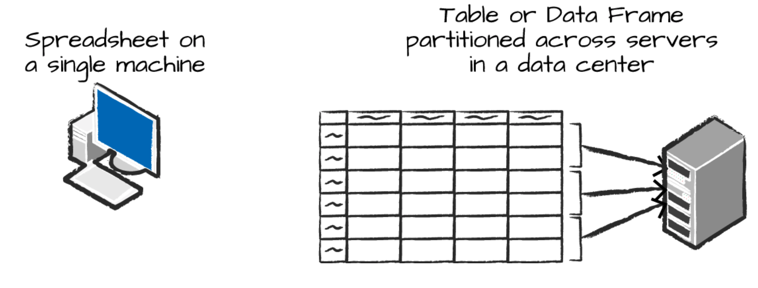
Spark DataFrames
Most common Structured API
Represents a table of data with rows and columns
The list that defines the columns and the types within those columns is called the schema.
Partition: A partition is a collection of rows that sit on one physical machine in the cluster. Partitions enable parallelism.
Discussion: Why do we need to put a dataframe on a cluster rather than one single machine?

Slide 27
Transformations
Core data structures in Spark are immutable, meaning they cannot be changed after they’re created.
To “change” a DataFrame, you need to instruct Spark how you would like to modify it to do what you want.
These instructions are called transformations. Transformations are lazy operations, meaning that they won’t do any computation or return any output until they are asked to by an action.

Slide 28
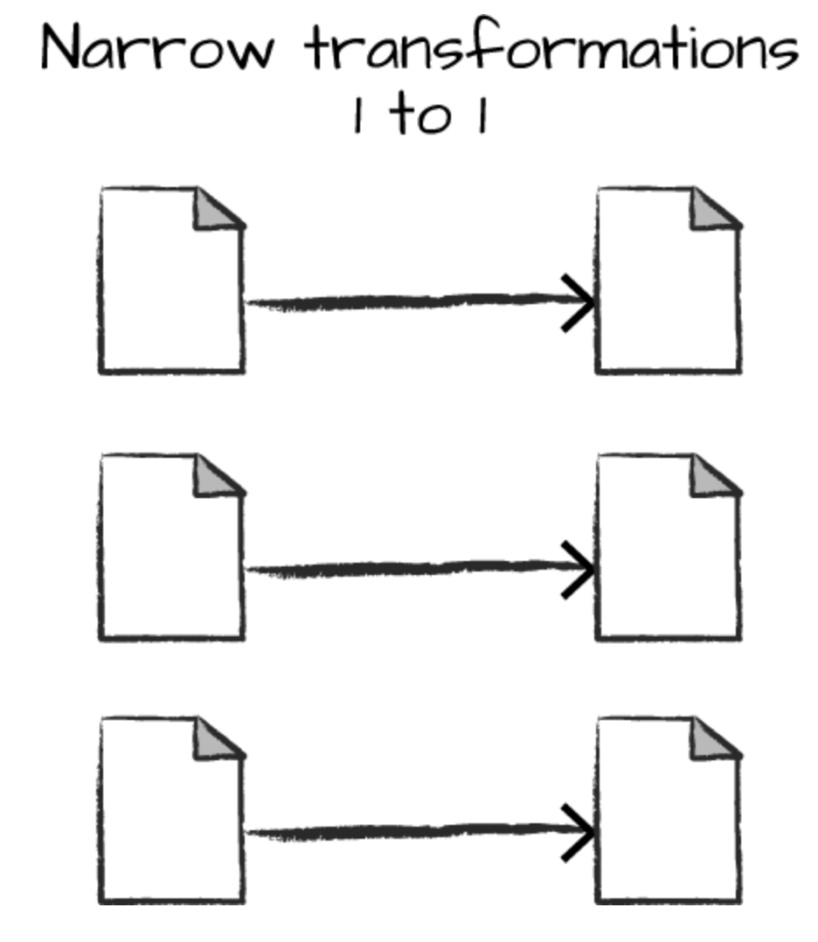
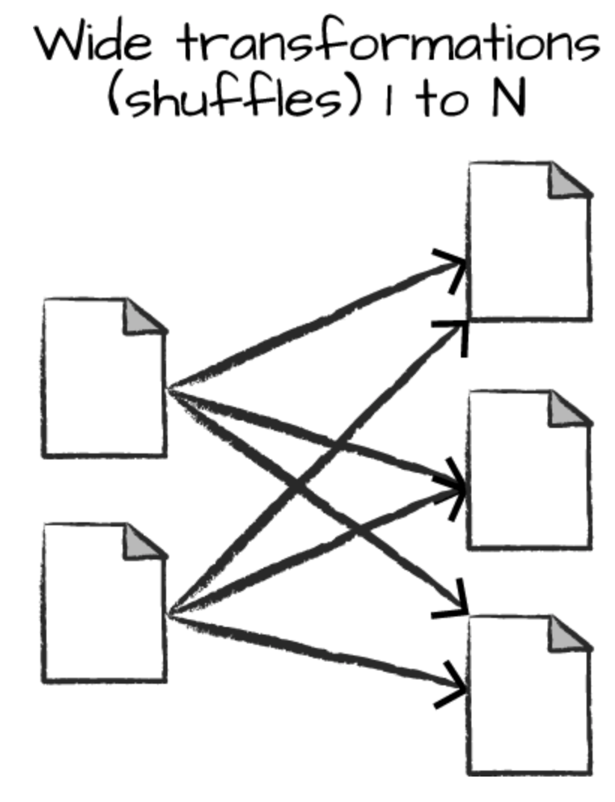
Types of Transformations
There are two types of transformations:
Narrow transformations
Each input partition will contribute to only one output partition
Wide transformations
Input partitions contributing to many output partitions
Spark will exchange partitions across the cluster
Also known as shuffle

Slide 29
Lazy Evaluation
Lazy evaluation means that Spark will wait until the very last moment to execute the graph of computation instructions.
This enables Spark to compile this plan from the raw DataFrame transformations to a streamlined physical plan that will run as efficiently as possible across the cluster.
Transformations (logical plan) Physical Plan

Slide 30
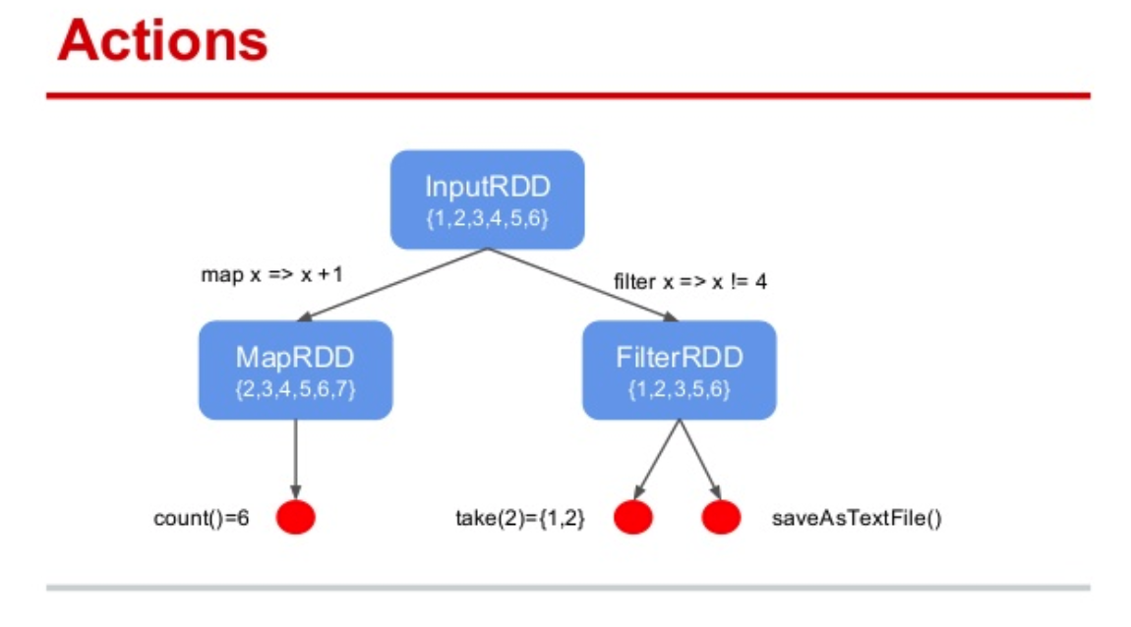
Actions
To trigger the computation, we run an action.
An action instructs Spark to compute a result from a series of transformations.
There are three kinds of actions:
Actions to view data in the console
Actions to collect data to native objects in the respective language
Actions to write to output data sources

Slide 31
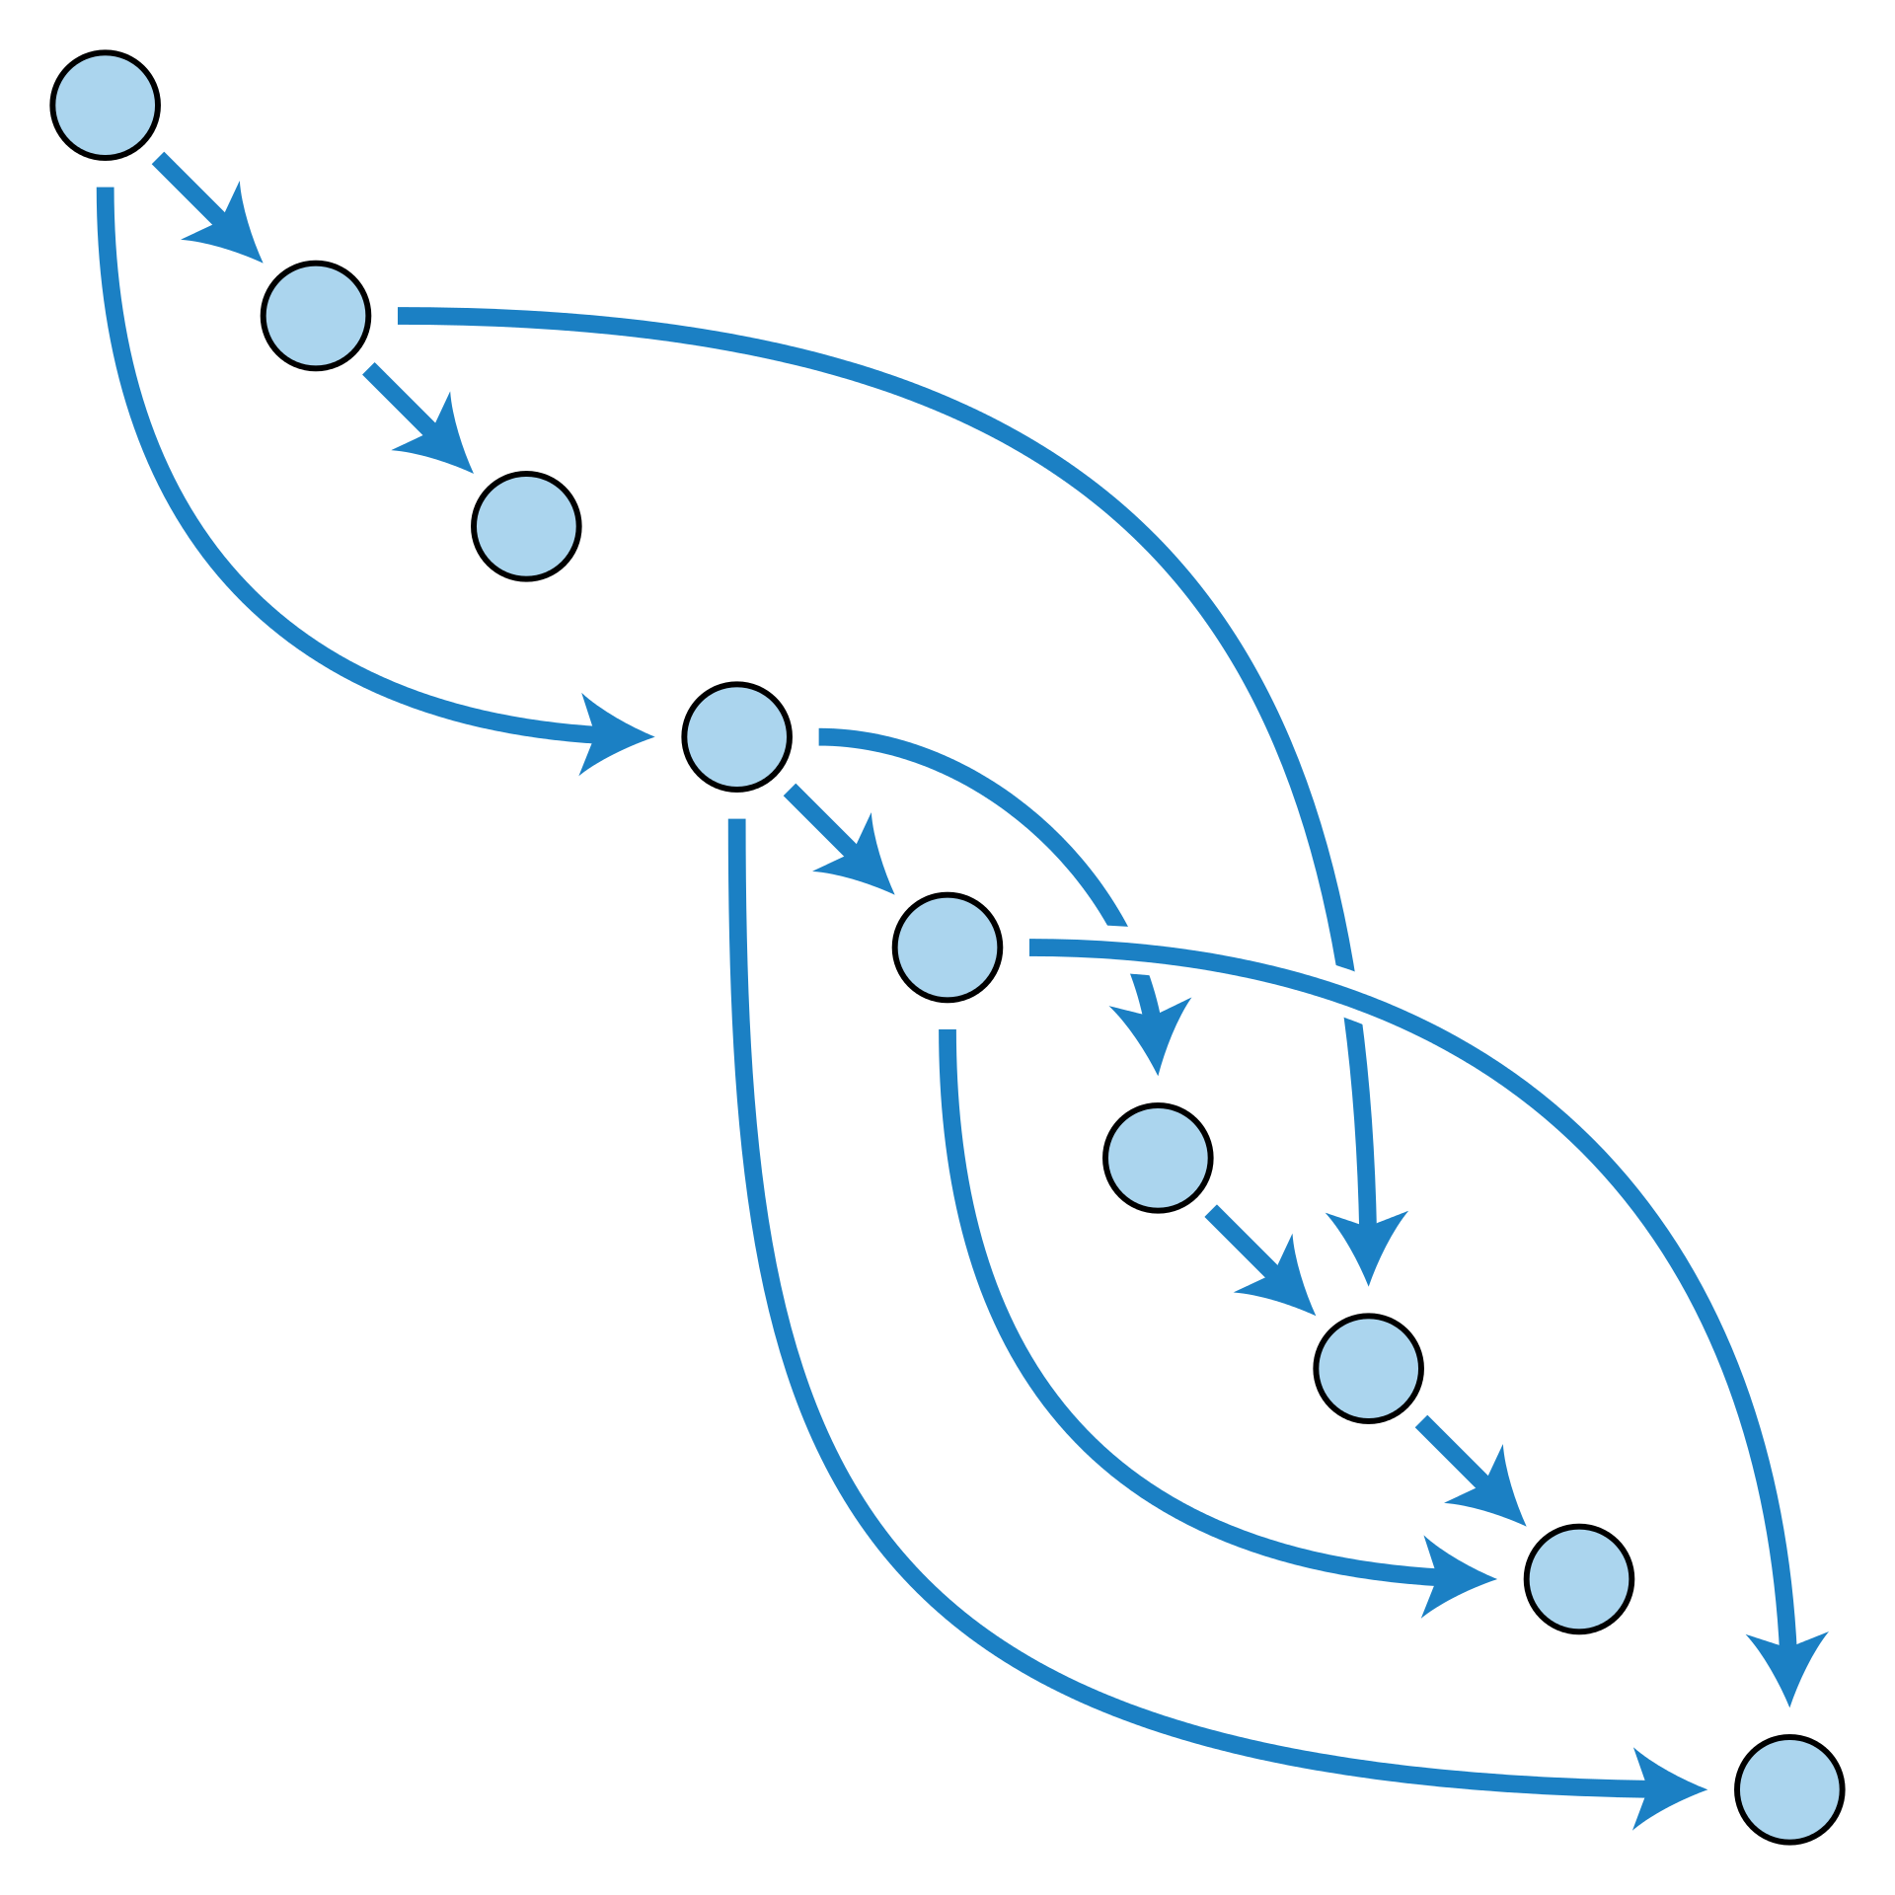
Directed Acyclic Graph (DAG)
DAG
A directed acyclic graph is a finite directed graph having no graph cycles.
Spark is a distributed programming model in which the user specifies transformations.
Multiple transformations build up a directed acyclic graph of instructions.
An action begins the process of executing that graph of instructions, as a single job, by breaking it down into stages and tasks to execute across the cluster.

Slide 32

Team Lead
Sign-up Form

Slide 33

Project Leads
I would like to identify 8 project leads. Leads should
have more experience in python
have more experience in SQL
be willing to help their fellow team members during the class for in-class exercises
be willing to coordinate their team to set up meetings related to the team assignment and project
Project leads will be evaluated by their fellow team members at the end of the semester.
What will you gain?
Leadership skills
Extra credit: Receive up to 5% extra credit in the final project grade.
If interested fill out this short form.

Slide 34
Launch a Spark Cluster on Google Cloud
Preview the following document and be prepared for the next class:
Deploy-Spark-Cluster-on-Google-Cloud-Dataproc.PDF

Slide 35

Activity
DataCamp assignments according to the syllabus
Assignment 2
Preview the Spark cluster document: Deploy-Spark-Cluster-on-Google-Cloud-Dataproc.PDF
Optional Qwiklab

Slide 36
Remember to Stop Your VM!

